Slide 1


<Name>
<Date>

Slide 2

Outline
Executive Summary
Introduction
Methodology
Results
Conclusion
Appendix

Slide 3
Executive Summary
Summary of methodologies:
Data collection
Data Wrangling (Cleaning)
Explore the Data:
Exploratory Data Analysis (EDA) using visualization and SQL
Interactive Visual Analytics using Folium and Plotly Dash
Modelling: Predictive Analysis using Classification Models
Assess the results
Summary of all results

Slide 4
Introduction
Project background and context:
  SpaceX advertises Falcon 9 rocket launches on its website with a cost of 62 million dollars; other providers cost upward of 165 million dollars each, much of the savings is because SpaceX can reuse the first stage. Therefore, if we can determine if the first stage will land, we can determine the cost of a launch.
Objective:
  Deliver your data-driven insights to determine if the first stage of Falcon 9 will land successfully.

Slide 5

Section 1

Slide 6
Methodology
Executive Summary
Data Collection
Data Wrangling
Exploratory Data Analysis (EDA) using visualization and SQL
Interactive Visual Analytics using Folium and Plotly Dash
Predictive Analysis using Classification Models

Slide 7
Data Collection
Requested rocket launch data from SpaceX API, parsed the table and converted it into a Pandas data frame (data_falcon9)
Extracted Falcon 9 launch records from HTML table in Wikipedia, parsed the table and converted it into a Pandas data frame (df)

Slide 8
Data Collection – SpaceX API
GitHub URL: README.md/jupyter-labs-spacex-data-collection-api.ipynb at main · DougBedore01/README.md
Start
Load Initial Launch Data
Get Booster Version
Get Launch Site Info
Get Payload Data
Get Core Data
Combine All Data into Final Dataframe
Display Final Data
End

Slide 9
Data Collection - Scraping
Start
GitHub URL: README.md/jupyter-labs-webscraping.ipynb at main · DougBedore01/README.md
Fetch HTML Page
Export Data
Parse HTML with BeautifulSoup
End
Locate Launch Data Table
Build Pandas DataFrame
Extract & Clean Table Headers
Iterate Through Table Rows
9

Slide 10
Data Wrangling
Start
Loading and Inspection: The dataset was loaded, and missing values were analyzed (e.g., 28.9% in LandingPad).
Data Exploration:
  Launch sites (CCAFS SLC 40 had the most launches) and orbits (GTO was most frequent) were summarized.
  Outcomes like True ASDS (successful drone ship landings) were counted.
Label Creation: A binary Class column was added (1 for success, 0 for failures like False Ocean).
Success Rate: The mean of Class gave the landing success rate.
Export: Cleaned data was saved to dataset_part_2.csv for further analysis.
GitHub URL: README.md/labs-jupyter-spacex-Data wrangling.ipynb at main · DougBedore01/README.md
Load Data
Identify Data Types
Exploratory Data Analysis
End
Create Binary Label
Create Success Rate
Export Cleaned Data

Slide 11
EDA with Data Visualization
1. Payload Mass vs Flight Number
  Chart type: Categorical scatter plot
  Purpose: To analyze how payload mass and flight number relate to mission success.
2. Launch Site vs Flight Number
  Chart type: Categorical scatter plot
  Purpose: To analyze how different launch sites perform over time and identify trends or consistency in success rates.
3. Launch Site vs Payload Mass
  Chart type: Categorical scatter plot
  Purpose: To explore if payload mass impacts success differently across launch sites.
4. Orbit Type vs Success Rate
  Chart type: Bar Plot
  Purpose: To visualize and compare success rates across different orbit types.

Slide 12
EDA with Data Visualization Part 2
5. Orbit vs Flight Number
  Chart type: Categorical scatter plot
  Purpose: To detect changes or patterns in orbit usage and success over time.
2. Orbit vs Payload Mass
  Chart type: Categorical scatter plot
  Purpose: To analyse the relationship between payload size and orbit success.
GitHub URL: README.md/edadataviz.ipynb at main · DougBedore01/README.md

Slide 13
EDA with SQL
SQL queries summarized:
Display the names of the unique launch sites in the space mission.
Display 5 records where launch sites begin with the string 'CCA'
Display the total payload mass carried by boosters launched by NASA (CRS)
Display average payload mass carried by booster version F9 v1.1
List the date when the first successful landing outcome in ground pad was achieved.
List the names of the boosters which have success in drone ship and have payload mass greater than 4000 but less than 6000
List the total number of successful and failure mission outcomes
List all the booster_versions that have carried the maximum payload mass, using a subquery with a suitable aggregate function.
List the records which will display the month names, failure landing_outcomes in drone ship ,booster versions, launch_site for the months in year 2015.
Rank the count of landing outcomes (such as Failure (drone ship) or Success (ground pad)) between the date 2010-06-04 and 2017-03-20, in descending order.
GitHub URL: README.md/jupyter-labs-eda-sql-coursera_sqllite.ipynb at main · DougBedore01/README.md

Slide 14
Build an Interactive Map with Folium
Map Initialization
  folium.Map(location=nasa_coordinate, zoom_start=10)
  A Folium map centered at the NASA Johnson Space Center coordinates.
Circle
  folium.Circle(...)
  A circle with a 1000-meter radius centered at NASA Johnson Space Center.
  Colored orange (#d35400) and includes a popup label: "NASA Johnson Space Center".
Marker with Text Label
  folium.Marker(..., icon=DivIcon(...))
  A marker at the same NASA location using a DivIcon (custom HTML text).
  Displays "NASA JSC" as an on-map label.
Explanation:
Map Initialization: Sets up the base map to visualize data.
Circle (NASA JSC): Highlights the specific location of NASA JSC on the map with a visible radius.
Text Marker (NASA JSC): Provides a readable label directly on the map, enhancing user understanding.
Other Launch Sites: To compare multiple launch site locations, which is important for geographic analysis.
GitHub URL: README.md/lab_jupyter_launch_site_location.ipynb at main · DougBedore01/README.md

Slide 15
Build a Dashboard with Plotly Dash
Summary of Plots/Graphs and Interactions:
Pie Chart: success-pie-chart
  Displays either:
  Total successful launches by site (when "All Sites" is selected).
  Success vs. failure for a selected launch site.
Created using Plotly Express px.pie().
Scatter Plot: success-payload-scatter-chart
  Shows payload mass vs. launch success (class), color-coded by booster version category.
  Dynamically filters data based on selected site and payload range.
Created using Plotly Express px.scatter().
Dropdown Menu: site-dropdown
  Allows users to select a specific launch site or view data from all sites.
  Triggers updates to both the pie chart and scatter plot.
Range Slider: payload-slider
  Lets users select a payload mass range (in kg).
  Affects the scatter plot to show only launches within the selected range.
GitHub URL: README.md/scapex-dash-app_2.py at main · DougBedore01/README.md

Slide 16
Predictive Analysis (Classification)
Data Preprocessing
Feature selection & encoding
Train-test split
Feature scaling
Model Building
Multiple classifiers tested: Logistic Regression, Decision Tree, SVM, KNN.
Pipeline used for automation and reproducibility
Evaluation
Used metrics: Accuracy, F1-score, Confusion Matrix
Cross-validation (GridSearchCV) for hyperparameter tuning
Model Tuning
Hyperparameter optimization via GridSearchCV
Feature importance analysis (for tree-based models)
Model Comparison
Compared performance using evaluation metrics
Identified best-performing model based on validation scores
Best Model Selection
Final model selected based on highest accuracy/F1 on validation/test set.
Test Accuracy on all models was identical: 0.8333
GitHub URL: README.md/SpaceX_Machine Learning Prediction_Part_5.ipynb at main · DougBedore01/README.md
Start
Data Processing
Model Building
Evaluation
End
Model Tuning
Model Comparison
Best Model Selection
16

Slide 17
Results
Exploratory data analysis results:
1. Payload Mass vs Flight Number
  Successful landings are more frequent for launches with higher flight numbers and moderate payload mass.
  Earlier missions (lower flight numbers) showed more failed attempts.
2. Launch Site Impact
  CCAFS SLC 40 and KSC LC 39A are major launch sites.
  Launches from KSC LC 39A had higher success rates.
3. Orbit Type and Success Rate
  LEO (Low Earth Orbit) missions had the highest success rate.
  Orbits like GTO had lower success probabilities.
  A bar chart of success rates grouped by orbit type was created.
4. Flight Number vs Orbit
  Later missions to certain orbits (e.g., ISS, LEO) had higher success rates.
5. Payload Mass vs Launch Site
  Larger payloads were often launched from KSC LC 39A.
  Some sites rarely handled heavier payloads or complex orbits.

Slide 18
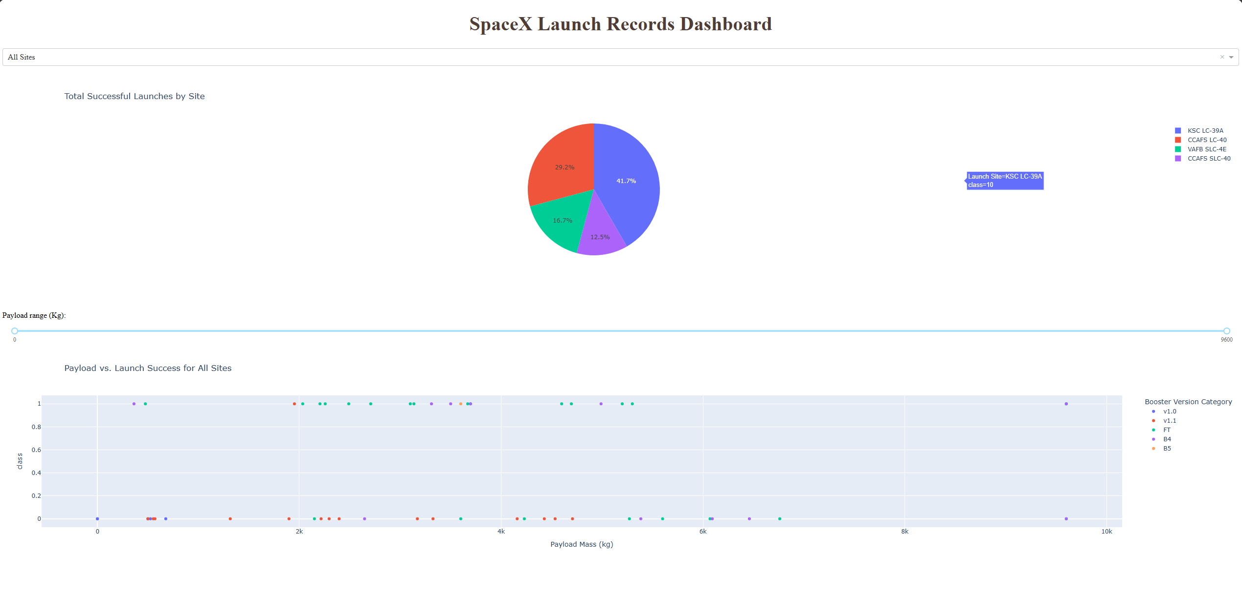
Results Part 2
Interactive analytics demo screenshot:
Predictive analysis results:
All models performed similarly, but SVM offered best balance of generalization and accuracy.
Features such as Orbit Type, Payload Mass, and Launch Site had strong predictive value.

Slide 19

Section 2

Slide 20
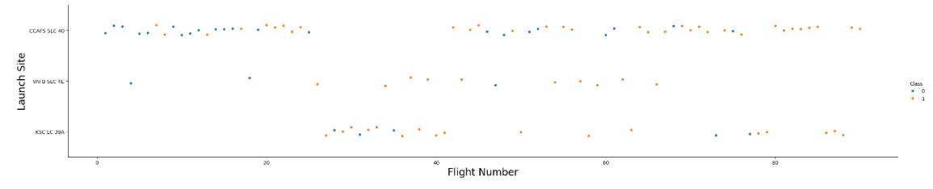
Flight Number vs. Launch Site
Flight Number vs. Launch Site
Earlier flights (lower flight numbers) had more failures.
Success rate improves over time — higher flight numbers show more successful landings, especially at KSC LC 39A.
KSC LC 39A shows a higher proportion of successful landings.
CCAFS SLC 40 has a mix but leans toward more successes in later flights.
VAFB SLC 4E has fewer launches, but most are failures or mixed.

Slide 21
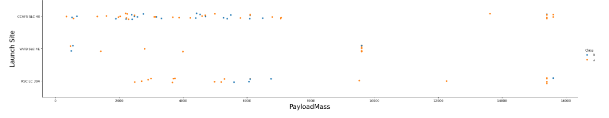
Payload vs. Launch Site
Payload vs. Launch Site
CCAFS SLC 40: The most frequently used site. Handles a wide range of payloads (from ~0 to ~15,600 kg).Shows a balanced mix of successful and failed landings, especially in the mid-payload range (2000–6000 kg).
KSC LC 39A: Used for heavier payloads (mostly > 5000 kg). High success rate, even at very high payloads (up to ~15,600 kg).
VAFB SLC 4E: Fewer launches overall. Mostly lighter payloads. Slight tendency toward more failures.

Slide 22
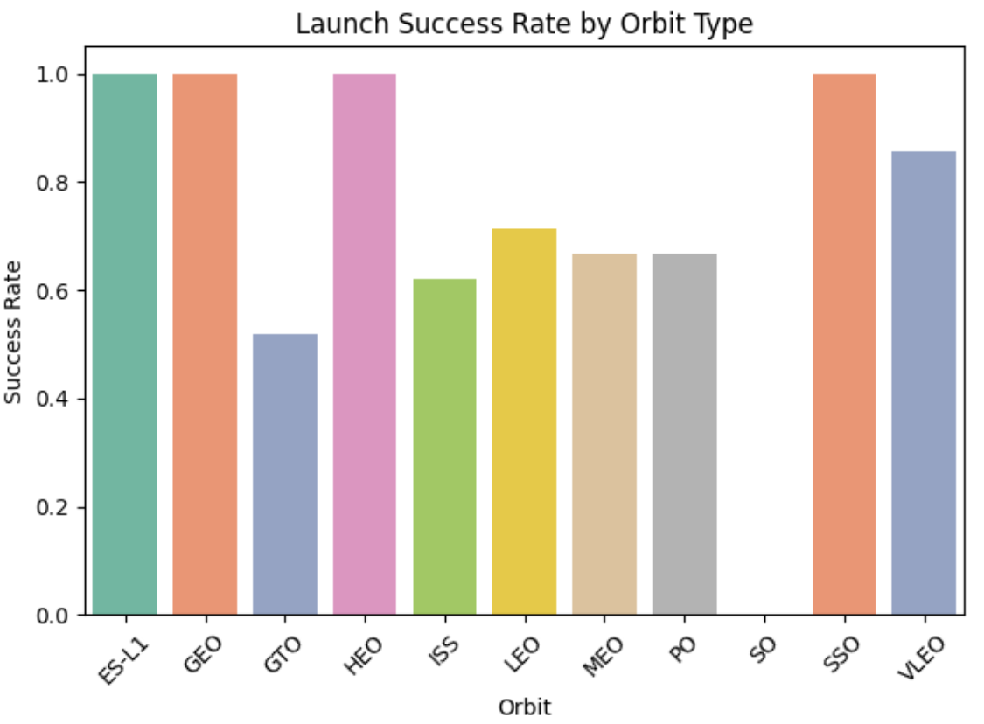
Success Rate vs. Orbit Type
Bar Chart for the success rate of each orbit type:
Orbit Types with Highest Success Rates (100%):
  ES-L1 (Earth-Sun Lagrange Point 1)
  GEO (Geostationary Orbit)
  HEO (Highly Elliptical Orbit)
  SSO (Sun-Synchronous Orbit)
Lower Success Rates
  GTO (Geostationary Transfer Orbit): ~52%
  ISS and LEO: ~60–70%

Slide 23
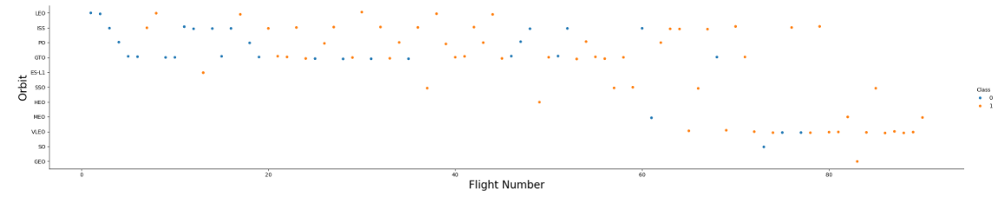
Flight Number vs. Orbit Type
Flight number vs. Orbit type
Early flights (Flight Numbers < 20):
  More failures (blue dots), especially in GTO and PO orbits.
Later flights (Flight Numbers > 40):
  More consistent success (orange dots), regardless of orbit type.
  Shows improved technology, better landing techniques, or refined booster systems.

Slide 24
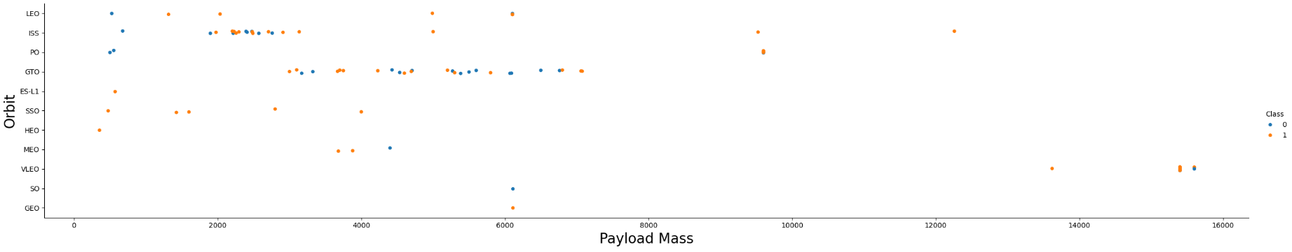
Payload vs. Orbit Type
Payload Mass vs. Orbit Type
Success is not determined by payload mass, heavy payloads can succeed if the mission is well-prepared.
Orbit type plays a crucial role, especially GTO, which is more failure-prone despite moderate payloads.
Missions with very large payloads tend to be carefully planned and have high success rates.

Slide 25
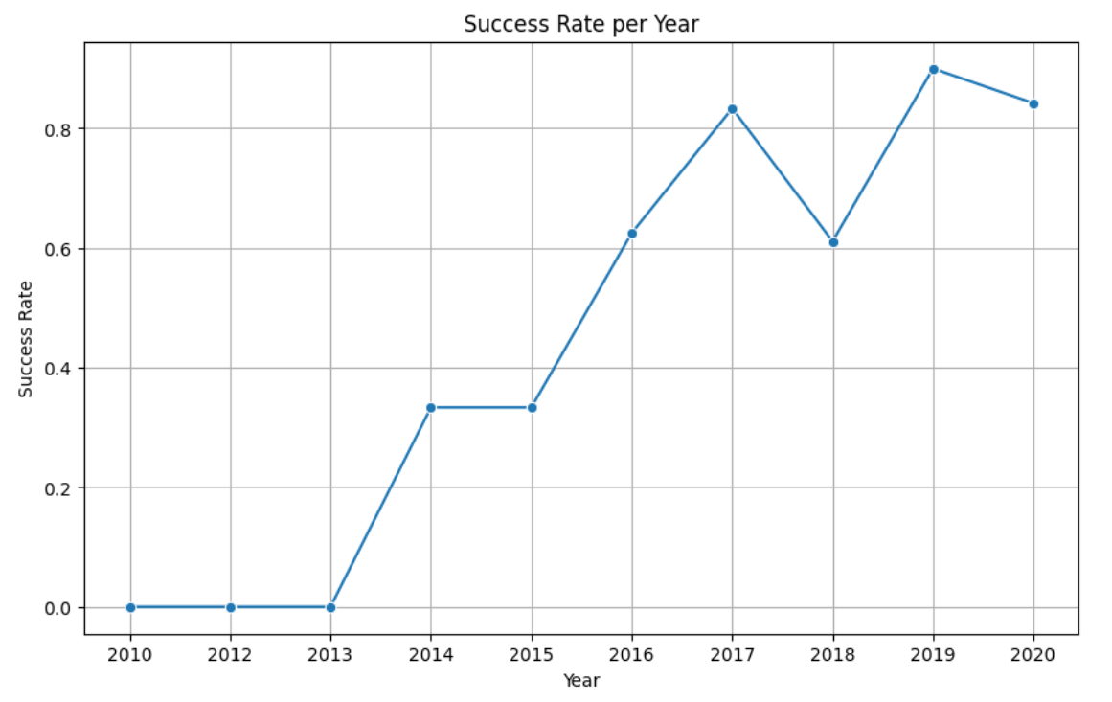
Launch Success Yearly Trend
Yearly Average Success Rate
Average Success Rate increases substantially on a yearly basis with the exception of 2018 where success rate dropped from 80% to 60%.

Slide 26
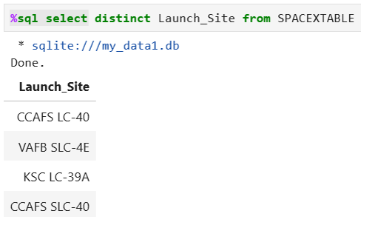
All Launch Site Names
Find the names of the unique launch sites
Used ‘distinct’ keyword to only display unique launch sites

Slide 27
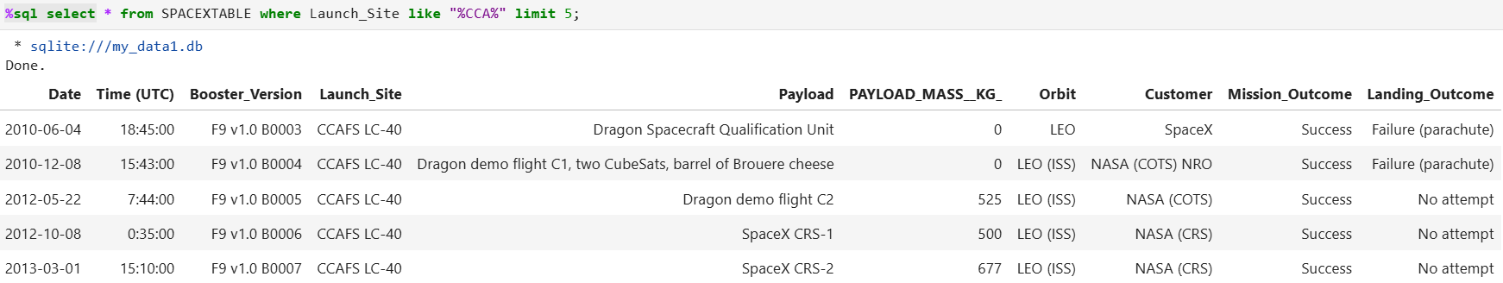
Launch Site Names Begin with 'CCA'
Find 5 records where launch sites begin with `CCA
Used keyword ‘like’ %CCA% to display launch sites that have ‘CCA’ in the name

Slide 28
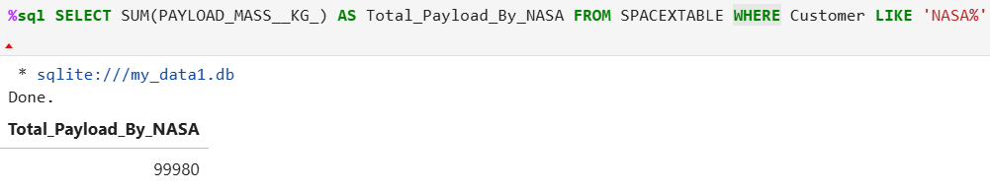
Total Payload Mass
Calculate the total payload carried by boosters from NASA
Calculated total using ‘sum’ function of all payloads carried by ‘NASA’

Slide 29
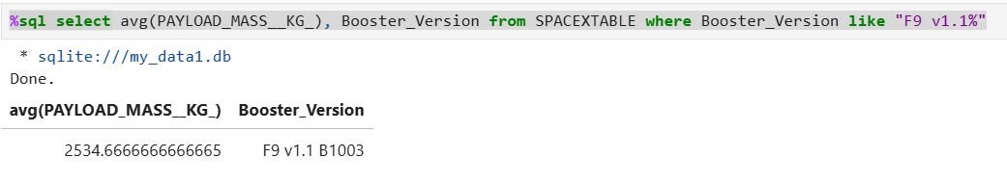
Average Payload Mass by F9 v1.1
Calculate the average payload mass carried by booster version F9 v1.1
Used ‘avg’ function to calculate average payload mass and keywords ‘where’ and ‘like’ to only include booster version F9 v1.1 in calculation

Slide 30
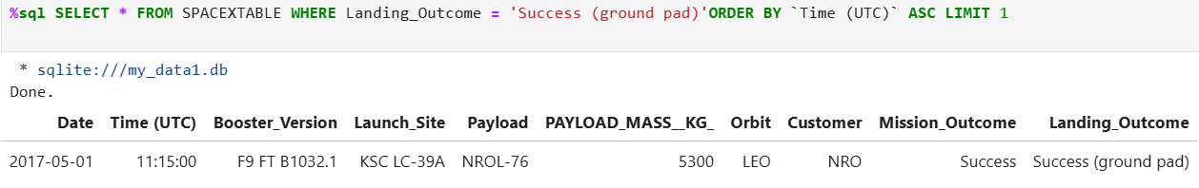
First Successful Ground Landing Date
Find the dates of the first successful landing outcome on ground pad
Used keyword ‘order by’ and ‘asc limit 1’ to order list of successful landing outcomes by time, only displaying the first result

Slide 31
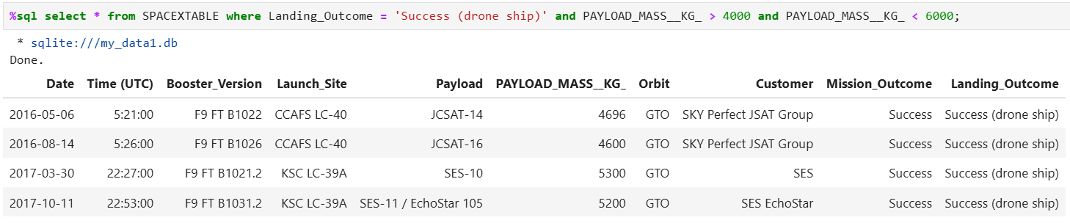
Successful Drone Ship Landing with Payload between 4000 and 6000
List the names of boosters which have successfully landed on drone ship and had payload mass greater than 4000 but less than 6000
Used keyword ‘where’ to group landings by ‘landing outcome’ and ‘payload mass’

Slide 32
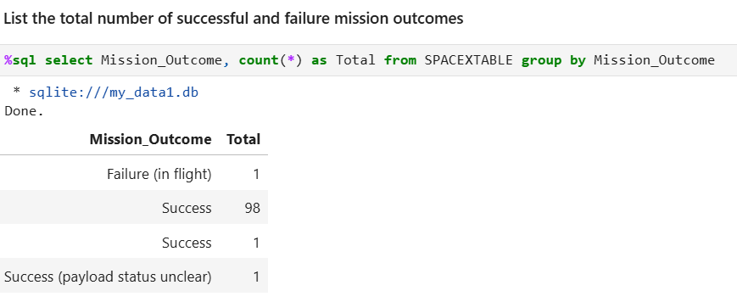
Total Number of Successful and Failure Mission Outcomes
Calculate the total number of successful and failure mission outcomes
Used ‘count(*)’ to calculate total landings grouping by ‘mission outcomes’

Slide 33
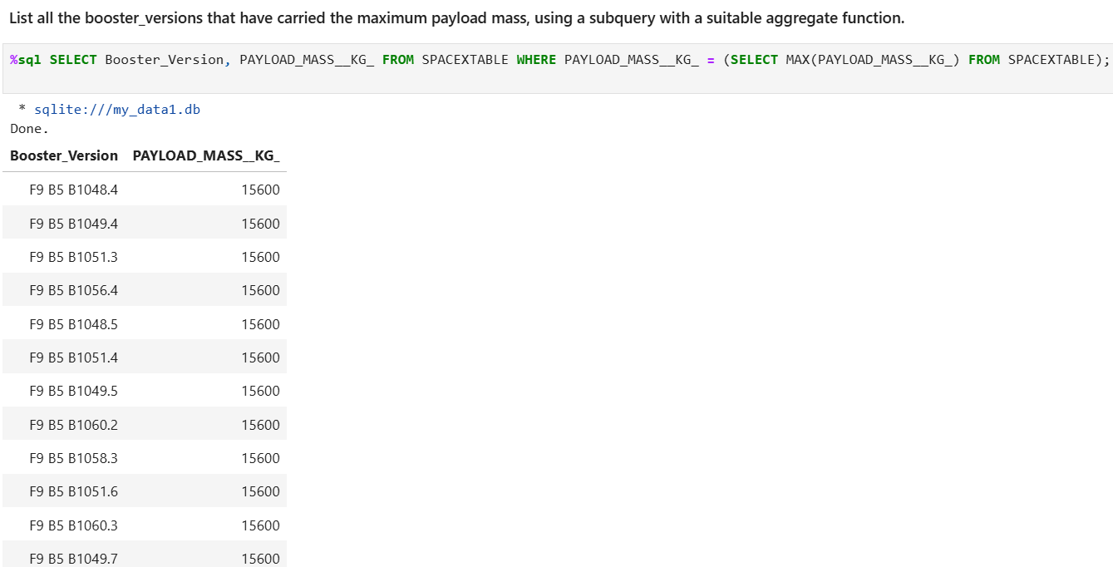
Boosters Carried Maximum Payload
List the names of the booster which have carried the maximum payload mass

Slide 34
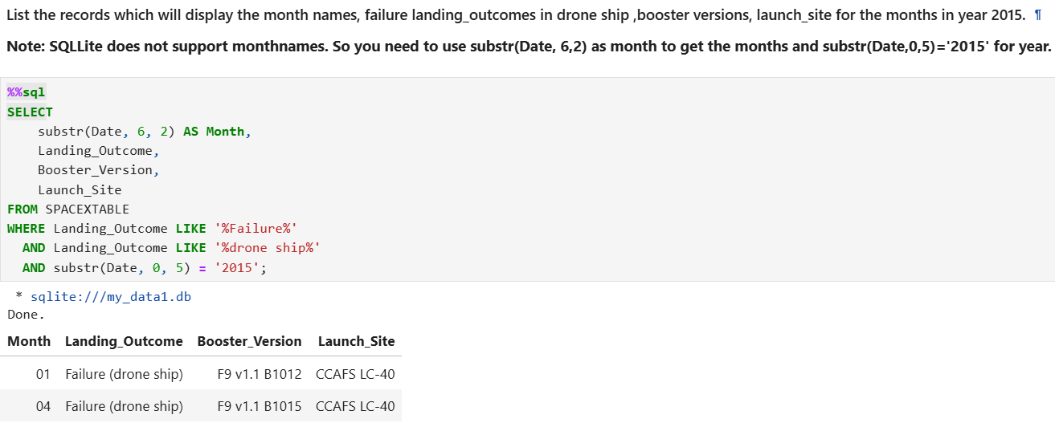
2015 Launch Records
List the failed landing_outcomes in drone ship, their booster versions, and launch site names for in year 2015

Slide 35
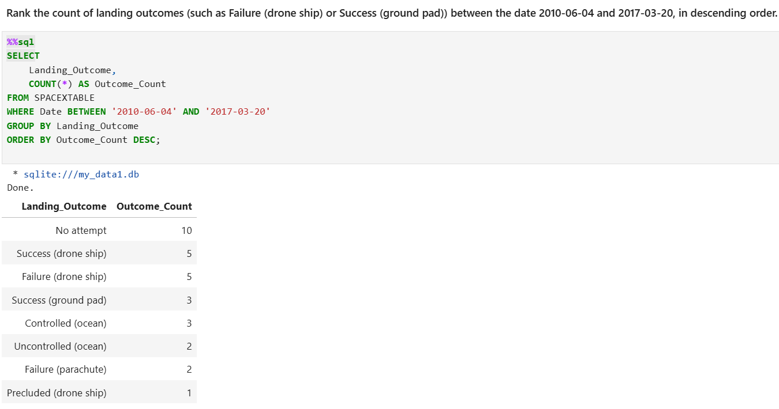
Rank Landing Outcomes Between 2010-06-04 and 2017-03-20
Rank the count of landing outcomes (such as Failure (drone ship) or Success (ground pad)) between the date 2010-06-04 and 2017-03-20, in descending order

Slide 36

Section 3

Slide 37
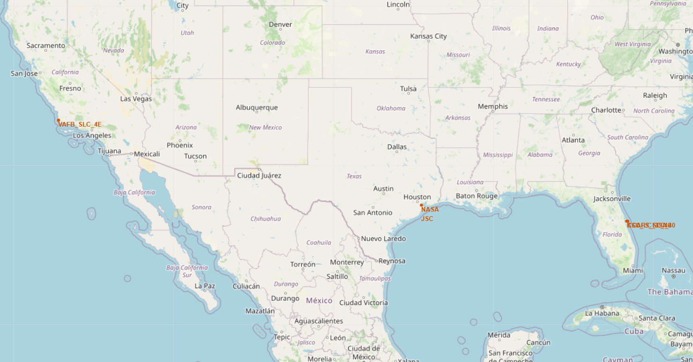
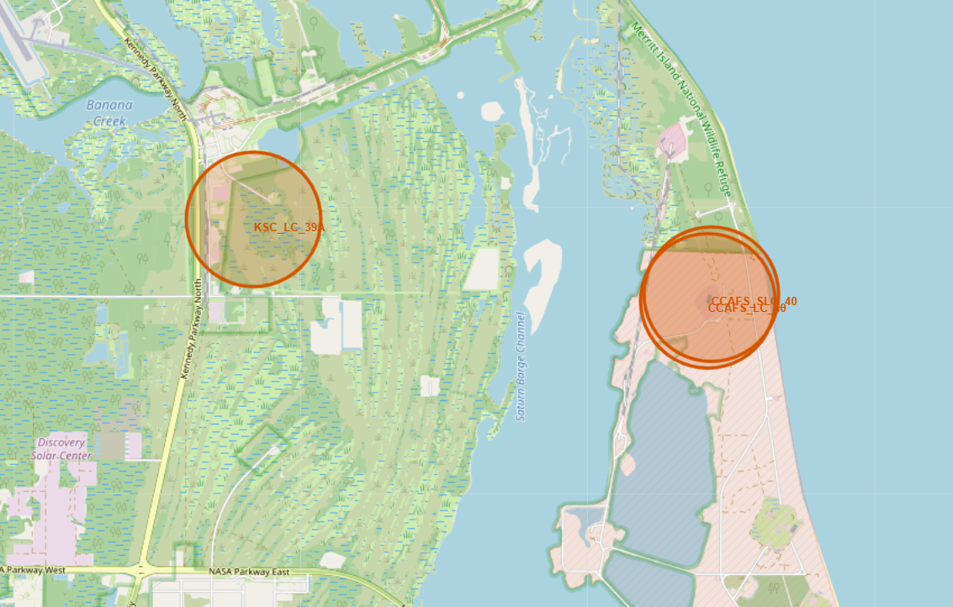
Marking Launch Sites on Folium
Screenshot of Data Launch Sites below
All launch sites are near the coast and as close as possible to the equator line within the United States territory.

Slide 38
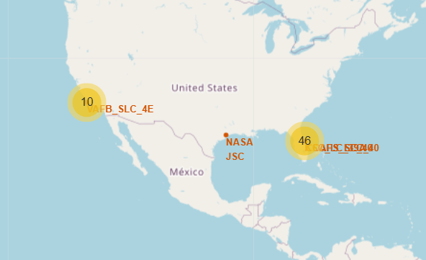
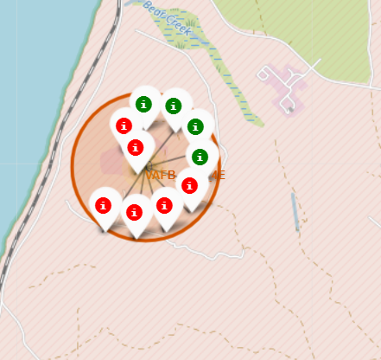
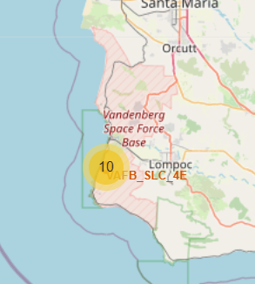
Launch Sites Success Rates Explored
KSC LC 39A shows a higher proportion of successful landings.
CCAFS SLC 40 has a mix but leans toward more successes in later flights.
VAFB SLC 4E has fewer launches, but most are failures or mixed.

Slide 39

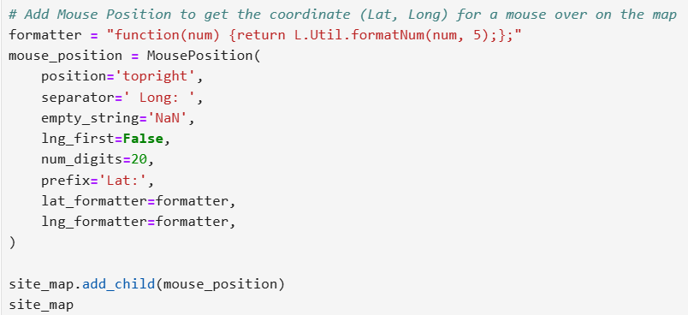
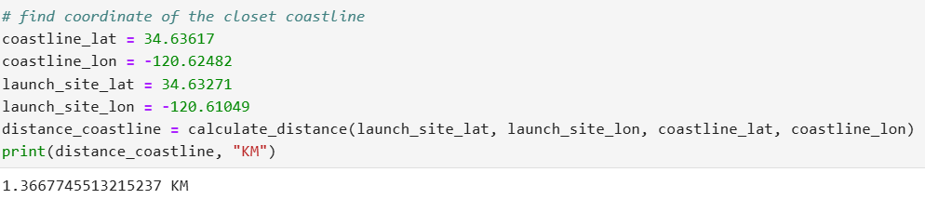
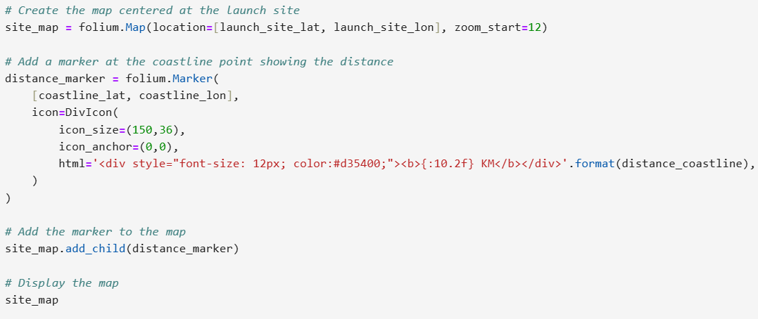
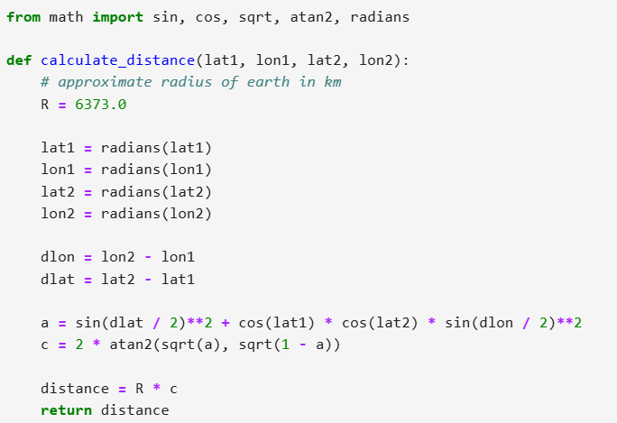
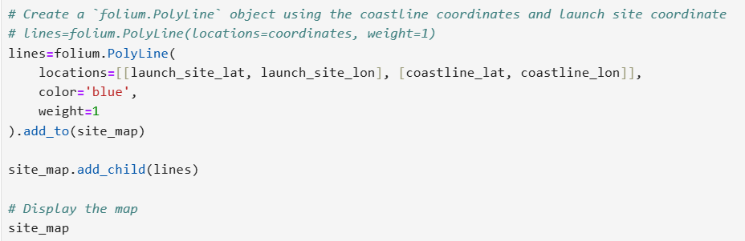
Distances Between a Launch Sites to its Proximities
Screenshot not available due to error:
Code broken down below:

Slide 40

Section 4

Slide 41
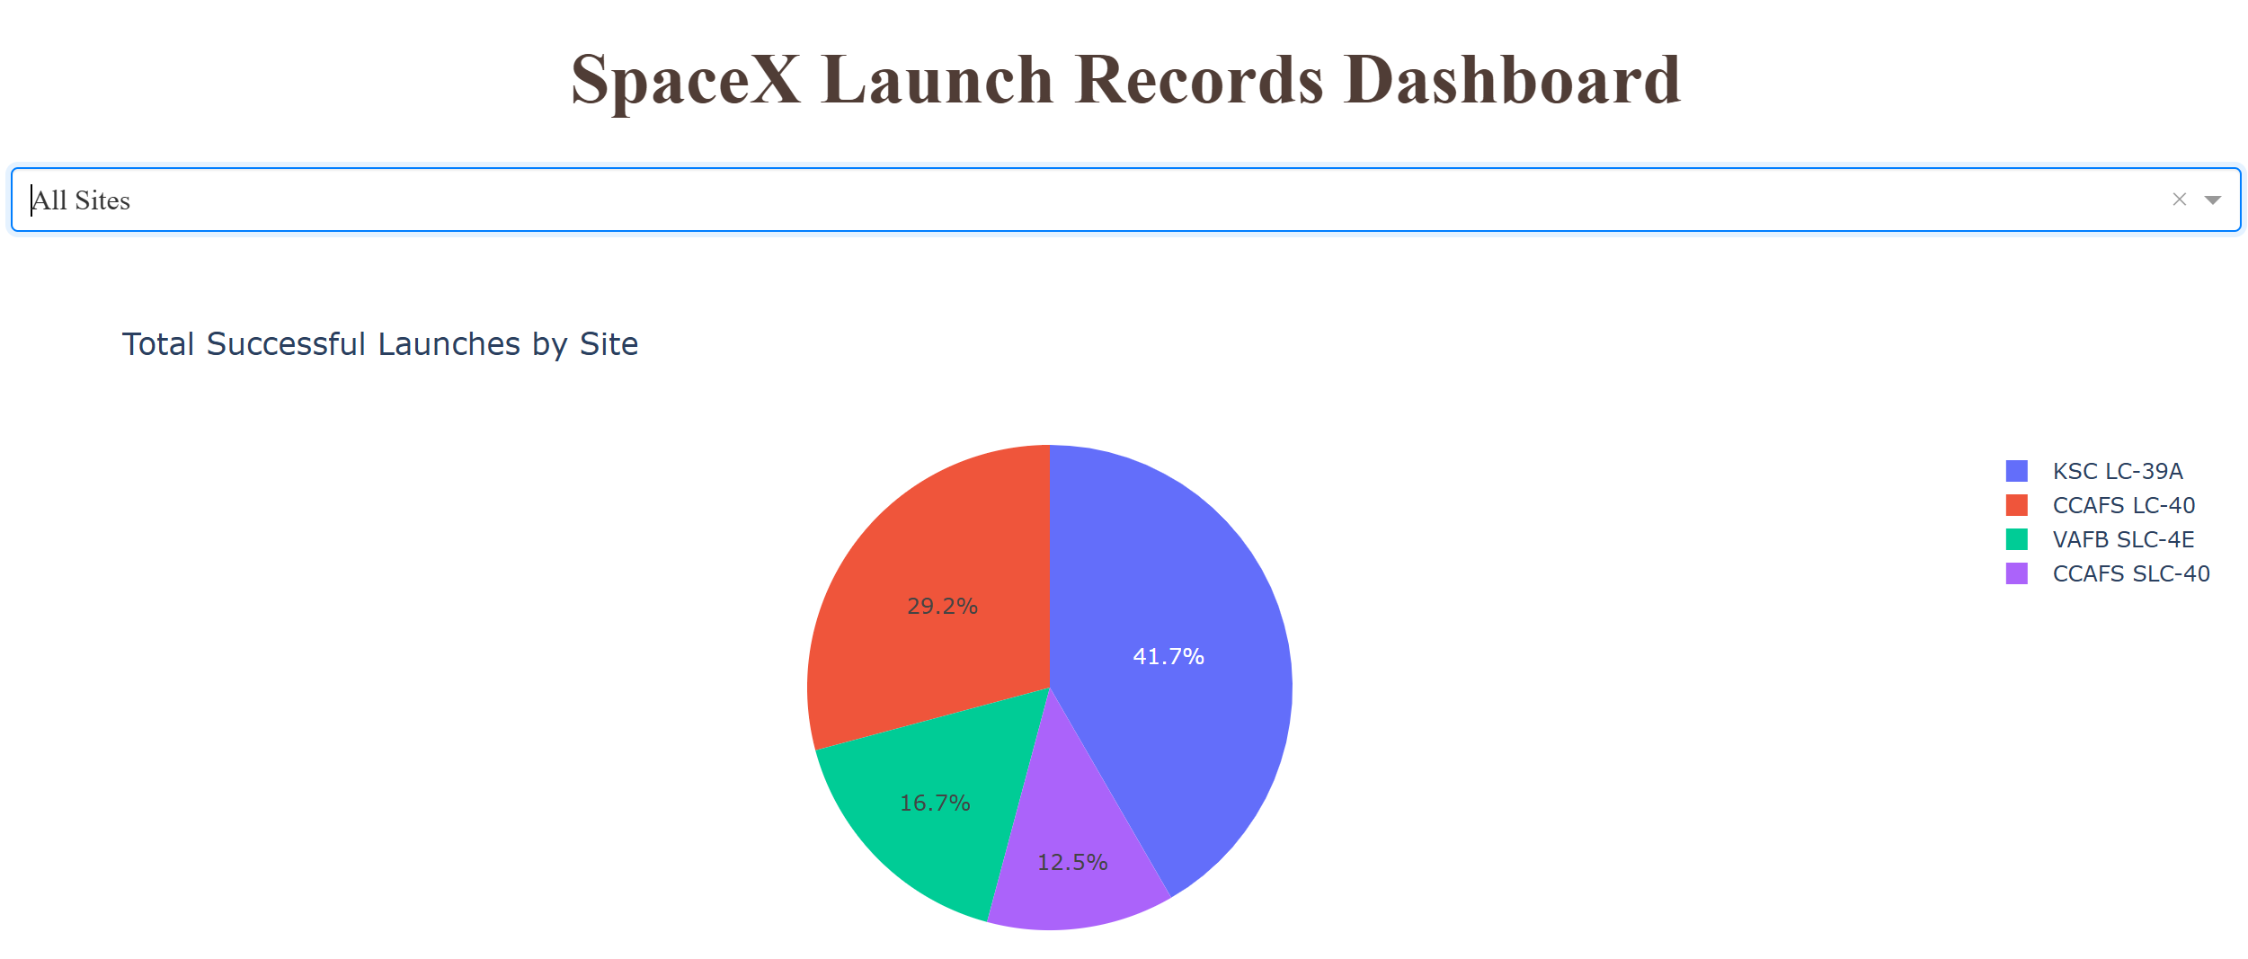
Launch Success Count for All Sites
Site with highest success rate: KSC LC-39A (41.7%), followed by CCAFS LC-40 (29.2%)
Sites with lowest success rate: VAFB SLC-4E (16.7%), followed by CCAFS SLC-40 (12.5%)

Slide 42
Launch site with Highest Launch Success Ratio
Site with highest success rate: KSC LC-39A (41.7%),

Slide 43
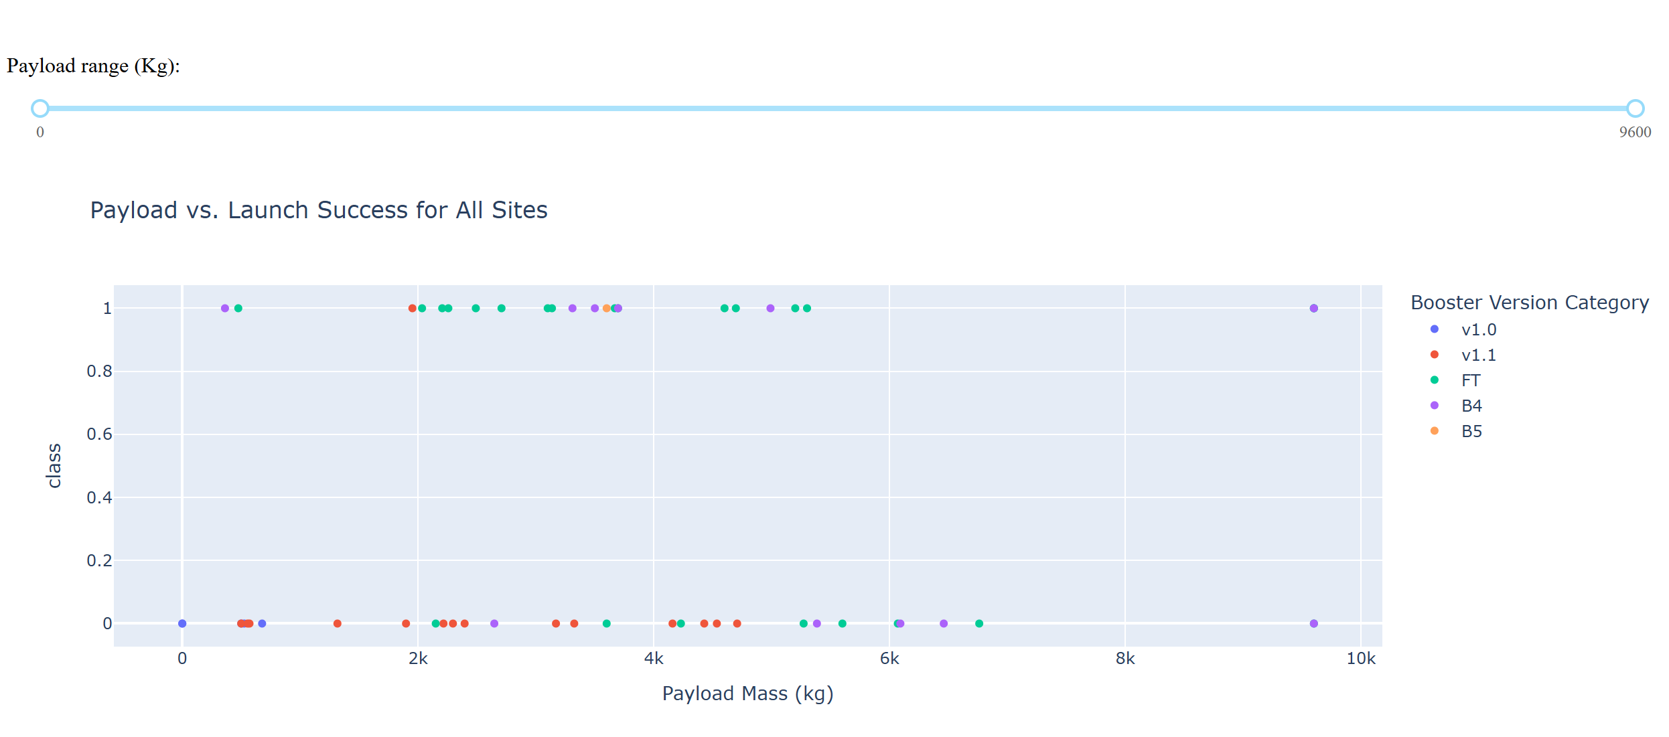
Payload vs. Launch Outcome Scatter Plot
Booster Versions FT and B4 dominate the successful launches.
v1.0 and v1.1 show more failures, especially at lower payloads — suggesting older versions were less reliable.
Payloads between 2,000–6,000 kg show the highest concentration of successes, regardless of booster version.
Very light payloads (<1,000 kg) and heavy payloads (>6,000 kg) tend to have a higher proportion of failures, though some exceptions exist.

Slide 44

Section 5

Slide 45
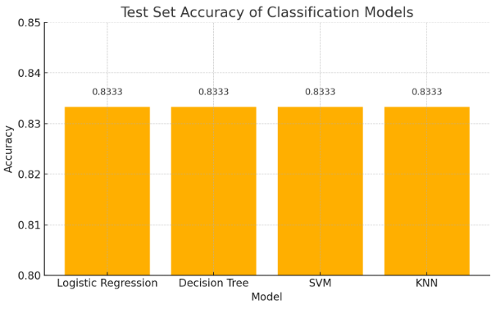
Classification Accuracy
Model Accuracy Bar Chart:
All models displayed the exact same model accuracy

Slide 46
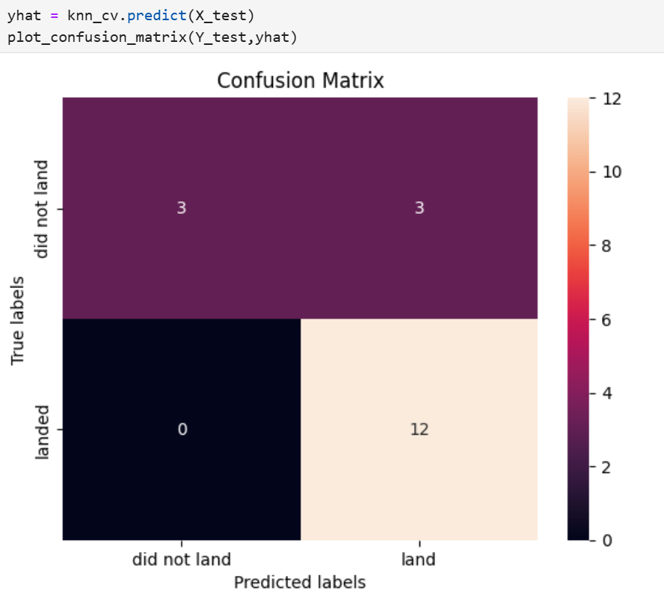
Confusion Matrix
Overview:
True Postive - 12 (True label is landed, Predicted label is also landed)
False Postive - 3 (True label is not landed, Predicted label is landed)

Slide 47
Conclusions
Launch success is influenced by experience — newer flight numbers are significantly more successful.
Orbit type is a strong predictor of outcome, with GTO being most risky and SSO/LEO the most reliable.
Mid-weight payloads (2,000–6,000 kg) tend to have the highest success rates, regardless of site or booster.
Booster versions matter — newer versions (FT, B4) clearly outperform older ones (v1.0, v1.1).
Launch site success varies — KSC LC 39A is the most reliable, VAFB SLC 4E the least.
All models performed equally (83.33% accuracy), with SVM offering better generalization, making it the preferred model.

Slide 48


